Slide 1
Asymmetric Cryptography II
Key exchange, encryption, digital signatures

Slide 2
Agenda
Overview: asymmetric cryptography algorithms
Diffie-Hellmann key exchange
ElGamal encryption
Digital signature algorithm (DSA)
RSA
Elliptic curves
Symmetric encryption
Next time ☺

Slide 3
Last time: Algorithms
Different mathematical algorithms have been developed that can perform asymmetric cryptography. Some (historically) notable are:
 | Secure communications | Digital signatures | Principle
1) Diffie-Hellman (DH) | ✔ |  | Discrete logarithm problem
2) Digital signature algorithm (DSA) |  | ✔ | Discrete logarithm problem
3) Rivest–Shamir–Adleman (RSA) | ✔ | ✔ | Prime numbers factoring problem
4) Elliptic curve Diffie-Hellman (ECDH) | ✔ |  | Same as above but math. operations on elliptic curves
5) Elliptic curve digital signature algorithm (ECDSA) |  | ✔

Slide 4
Algorithms – leaving out elliptic curves (for now)
Different mathematical algorithms have been developed that can perform asymmetric cryptography. Some (historically) notable are:
 | Secure communications | Digital signatures | Principle
1) Diffie-Hellman (DH) | ✔ |  | Discrete logarithm problem
2) Digital signature algorithm (DSA) |  | ✔ | Discrete logarithm problem
3) Rivest–Shamir–Adleman (RSA) | ✔ | ✔ | Prime numbers factoring

Slide 5
Updated: Implementations
Different mathematical frameworks have been developed that can perform asymmetric cryptography. Some (historically) notable are:
 | Key exchange (for symmetric cryptography) | Encryption | Signature | Principle
1) Diffie-Hellman (DH) | ✔ | x |  | Discrete logarithm problem
2) Elgamal encryption | (✔) | ✔ |  | „
3) Elgamal signature |  |  | ✔ | „
4) Digital signature algorithm (DSA) |  |  | ✔ | „
5) Rivest–Shamir–Adleman (RSA) | (✔) | ✔ | ✔ | Prime numbers factoring

Slide 6




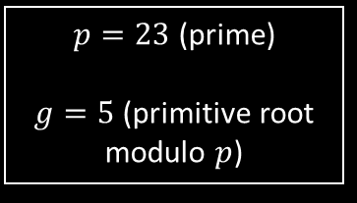
Diffie-Hellmann
In Diffie-Hellmann a mutual key (usable for symmetric encryption) is created by exchange of certain information
Public information
ALICE
$p=23$ (prime)
$g=5$(primitive root modulo $p$)
BOB
$a≔4$ (Alice‘s secret integer)
$$A≔g^{a} mod p=8$$
Shared secret $s$: $$s=B^{a}=18={(g^{b} mod p)}^{a} mod p$$
$b≔3$ (Bob‘s secret integer)
$$B≔g^{b} mod p=10$$
Shared secret $s$: $$s=A^{b}=18={(g^{a} mod p)}^{b} mod p$$
Works because g was chosen as primitve root modulo p

Slide 7

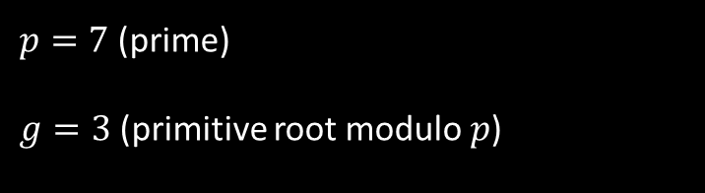
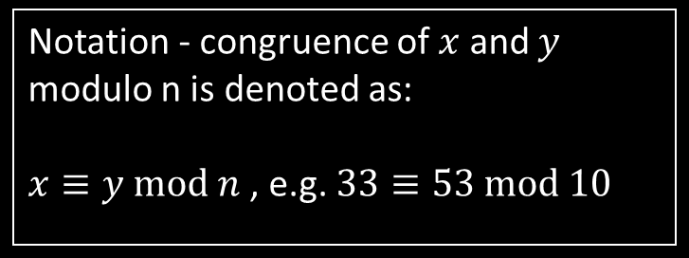

Fundamentals: primitive root & congruence
g is a primitive root modulo p if it creates a cyclic group with elements A of period (p-1) for the following equation
$$A≔g^{a} mod p, a∈ℕ$$
a | $$g^{a}$$ | $$A≔g^{a} mod p$$
1 | 3 | 3
2 | 9 | 2
3 | 27 | 6
4 | 81 | 4
5 | 243 | 5
6 | 729 | 1
7 | 2187 | 3
8 | 6561 | 2
9 | … | …
$p=7$ (prime)
$g=3$(primitive root modulo $p$)
Notation - congruence of $x$ and $y$ modulo n is denoted as:
$x≡y mod n$ , e.g. $33≡53 mod 10$

Slide 8
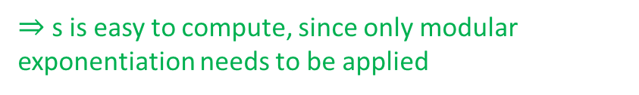
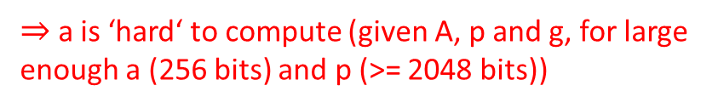
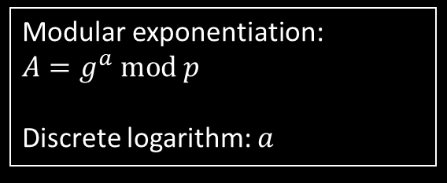

Principle behind Diffie-Hellmann
The discrete logarithm is ‘hard’ to compute and modular exponentiation is ‘easy’ to compute ‘one-way function’
Public information
Definitions
ALICE
$p=23$ (prime)
$g=5$(primitive root modulo $p$)
Modular exponentiation: $$A=g^{a} mod p$$
Discrete logarithm: $a$
$a≔4$ (Alice‘s secret integer)
$$A≔g^{a} mod p=8$$
Shared secret $s$: $$s=B^{a}=18={(g^{b} mod p)}^{a} mod p$$
$⇒$ a is ‘hard‘ to compute (given A, p and g, for large enough a (256 bits) and p (>= 2048 bits))
This is the discrete logarithm problem
$⇒$ s is easy to compute, since only modular exponentiation needs to be applied

Slide 9


ElGamal encryption
ElGamal was derived from Diffie-Hellmann and is used for asymmetric message encryption based the discrete logarithm problem
BOB
ALICE
Wants to receive encrypted messages
Choose prime $p=29$, and generator $g=2$
Choose private key: $b=5$
Computes $B=g^{b} mod p=3$
Publishes public key $(p,g,B)$
Wants to encrypt and send Bob the message $m=6$
Creates own secret $a=4$
Computes shared secret:
$s=B^{a} mod p=23$
$\text{Computes} A=g^{a} mod p=16$
Encrypts message as $X=\left(m∙s\right) mod p=22$
Sends $\left(A,X\right)$ to Bob

Slide 10


ElGamal encryption
ElGamal was derived from Diffie-Hellmann and is used for asymmetric message encryption based the discrete logarithm problem
BOB
ALICE
Computes shared secret: $s=A^{b} mod p=23$
Computes inverse of $s$: $s^{−1}=24$
Decrypts message by: $m=\left(X∙s^{−1}\right) mod p=6$
Wants to encrypt and send Bob the message $m=6$
Creates own secret $a=4$
Computes shared secret: $s=B^{a} mod p=23$
$\text{Computes} A=g^{a} mod p=16$
Encrypts message as $X=\left(m∙s\right) mod p=22$
Sends $\left(A,X\right)$ to Bob

Slide 11

Fundamentals: Modular multiplicative inverse
The modular multiplicative inverse with respect to modulus p, denoted as “${( )}^{−1}$”, is defined in the following way:
$$s⋅s^{−1} mod p=1$$
$s^{−1}$ is calculated with the Euclidean algorithm and Bézout's identity
Previous example: $$p=29;s=23;s^{−1}=24 \\ 23⋅24 mod 29=552 mod 29=1$$

Slide 12


Digital signature algorithm (DSA)
DSA was developed based on the Elgamal signature algorithm (different from Elgamal encryption), also using the discrete logarithm problem
BOB
Wants to create digital signature for the public key $(p,g,B)$
Choose random integer: $k=15∈[1,q−1]$
Choose ‘arbitrary‘ message $m$
Compute hash $h=Hash \left(m\right)=41$ (in practice SHA-1 algorithm)
$\text{Computes}$ $r=\left(g^{k} mod p\right) mod q=19$ $k^{′}=k^{−1} mod q=22$ $s=k^{′}\left(h+br\right) mod q=30$
Sends message $m$ and signature $(r,s)$
Create message and signature
Wants to prove a digital identity
Choose prime: $p=283$, generator: $g=60$, and prime divisor of $(p−1)$: $q=47$
Choose private key: $b=24$
Computes $B=g^{b} mod p=3$
Publishes public key $(p,g,q, B)$
Key generation

Slide 13


Digital signature algorithm (DSA)
DSA was developed based on the Elgamal signature algorithm (different from Elgamal encryption), also using the discrete logarithm problem
ALICE
Inputs: $\left(p,g, q, B\right)$; $m$; $(r,s)$
Wants to verify signature by Bob
Computes $h=Hash \left(m\right)=41$ $w=s^{−1} mod q=11$ $u_{1}=hw mod q=28$ $u_{2}=rw mod q=21$ $v=\left(g^{u_{1}}A^{u_{2}} mod p\right) mod q=19$
Check: $v==r$, if yes, signature is verified!
Security standards (FIPS189):
$$\left(\left|p\right|,\left|q\right|\right)=\left(1024,160\right);\left(2048,224\right);(3072,256)$$

Slide 14

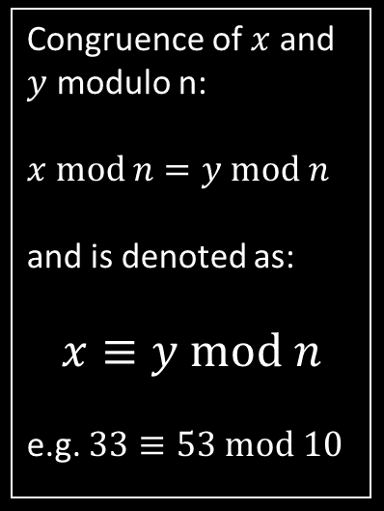

RSA (Rivest-Shamir-Adleman)
RSA is a special cryptographic algorithm because it can perform message encryption AND digital signatures
BOB
Choose integer $e=3,$ $1<e<φ$, so that: gcd $\left(e,φ\right)=1$
Compute secrete exponent $d=7$, $1<d<φ$, so that: $d=e^{−1}$ ($ed≡1 mod φ$), i.e. $e$ and $d$ are modular multiplicative inverses (slide 11)
Keep private key secret: $\left(p,q,d\right)$
Publish public key: $\left(n,e\right)$
Congruence of $x$ and $y$ modulo n:
$$x mod n=y mod n$$
and is denoted as:
$$x≡y mod n$$ e.g. $33≡53 mod 10$
Wants to receive encrypted messages AND send out digital signatures
Choose two (normally large) primes: $p=11$, $q=3$
Compute $n=p⋅q=33$ $φ=(p−1)(q−1)=20$
Key generation

Slide 15


RSA (Rivest-Shamir-Adleman)
Message encryption and decryption
ALICE
BOB
Wants to send Bob an encrypted message (cipher) using public key $\left(n,e\right)=(33,3)$
Choose message $m=7$
Compute cipher $c=m^{e} mod n=13$
Send cipher $c$ to Bob
Receives cipher $c$
Computes message $m=c^{d} mod n={13}^{7} mod 33=7$
Bob has succesfully decrypted the message $m$ from the cipher $c$ using his secret exponent $d$
Message encryption
Message decryption

Slide 16


Discrete logarithm vs. prime number factoring
Two distinct algorithm kinds, based on different ‘problems’:
Discrete logarithm problem (Diffie-Hellmann, ElGamal)
Problem of prime number factoring (RSA)
One result of this is the existence of a ‘trapdoor’ in RSA, which makes it possible to compute the inverse function…
ElGamal encryption
RSA
$s=B^{a} mod p$ $=A^{b} mod p$ $$X=\left(m∙s\right) mod p$$ $$m=\left(X∙s^{−1}\right) mod p$$
$$c=\left(f\left(m,e\right)\right)=m^{e} mod n$$ $$m=\left(f^{−1}\left(c,d\right)\right)=c^{d} mod n$$
→ This slide needs improvement

Slide 17
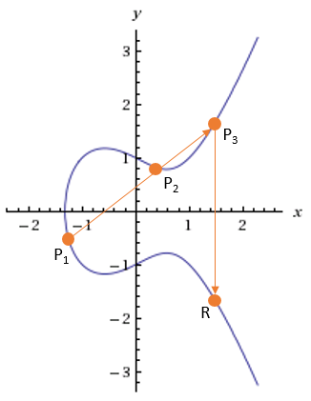
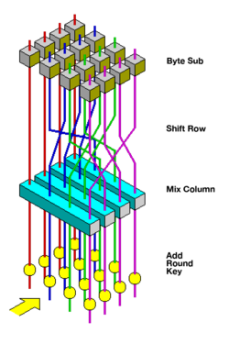
Next time(s)
1) Elliptic curve cryptography 2) Symmetric cryptography (e.g. AES)

